Slide 1

Final Review
Real-Time Drowsiness Detection Using Hybrid Computer Vision and Dlib with Deep Learning Classification
Batch No : 12
C. Narendra [21HR1A3011]
M. Hemagiri [21HR1A3028]
P. Yashwanth [21HR1A3040]
Under the Guidance of
Mr. K Lokesh, M. Tech(Ph.D)
Assoc. Prof & HOD of AI&DS
S. Vasantha Vani [21HR1A3047]
S. Muneera [21HR1A3051]
8 Apr 2025
RL-TIME-DROWSINESS DETECT –USING OPEN–CV & Dlib WITH DL CLASSIFICATION
1

Slide 2
ABSTRACT
Driver drowsiness is a significant safety concern, contributing to delayed reaction times and impaired decision-making. This project presents a real-time driver drowsiness detection system combining computer vision techniques and machine learning algorithms. Using OpenCV and Haar cascade classifiers, the system detects the driver’s face and extracts facial landmarks with dlib’s robust 68-point detector. Key metrics, including the Eye Aspect Ratio (EAR) and lip distance, are calculated to monitor eye closure and yawning, which are primary indicators of fatigue. Based on these features, the system classifies driver states active, drowsy, or yawning and triggers alerts using real-time processing. This non-intrusive solution enhances automotive safety by preventing fatigue-related accidents through timely interventions.
Keywords: Driver drowsiness detection, OpenCV, Haar Cascades,Dlib, Eye Aspect Ratio (EAR), Blink Rate, Real-time Object Detection.
8 Apr 2025
RL-TIME-DROWSINESS DETECT –USING OPEN–CV & Dlib WITH DL CLASSIFICATION
2

Slide 3
EXISTING SYSTEM
Limitations of Traditional Machine Learning Models: Machine learning algorithms like SVM and Random Forests classify features such as eye closure and yawning, but they rely on predefined features, limiting their effectiveness in diverse real-world conditions.
Challenges with Deep Learning Approaches: Deep learning methods like CNNs improve feature extraction for facial landmarks, but they struggle with real-time performance on low-power devices. LSTMs excel at analyzing sequences, but require large amounts of training data to generalize effectively.
Issues with Hybrid ML-DL Systems : Hybrid approaches combining ML and DL improve performance but struggle to balance accuracy and efficiency. They are also prone to errors due to dynamic changes like fluctuating lighting or different camera angles, reducing reliability.
8 Apr 2025
RL-TIME-DROWSINESS DETECT –USING OPEN–CV & Dlib WITH DL CLASSIFICATION
3

Slide 4
PROPOSED SYSTEM
Methodology Overview:
Input to Output Flow: The system captures live video of the driver’s face using an webcam. Haar cascade classifiers and dlib's facial landmark detection identify facial regions. Key metrics, such as the Eye Aspect Ratio (EAR) and lip distance, are computed to classify the driver as active, drowsy, or yawning. Alerts are triggered if drowsiness or yawning is detected.
Modular Design:
Face Detection with Haar Cascade Classifiers: Rapidly identifies the driver's face in real-time, establishing a reliable Region of Interest (ROI) for further analysis.
Facial Landmark Detection with Dlib: Utilizes pre-trained models to detect 68 facial landmarks, enabling accurate tracking of eyes and mouth.
8 Apr 2025
RL-TIME-DROWSINESS DETECT –USING OPEN–CV & Dlib WITH DL CLASSIFICATION
4

Slide 5
PROPOSED SYSTEM
Metric Computation (EAR and Lip Distance): Computes EAR for eye closure detection and lip distance for yawning analysis. These serve as key indicators for drowsiness classification.
Classification Mechanism: Classifies driver states (active, drowsy, yawning) based on thresholds for EAR and lip distance, ensuring accurate classification under real-time conditions.
Real-Time Alerts and Notifications: When thresholds are crossed for EAR or lip distance, the system emits audible warnings. Persistent alerts trigger SMS notifications via Twilio to designated contacts.
Adaptability and Scalability: Ensures robust detection under varying conditions (e.g., lighting, head orientation) and provides modular flexibility for adding features like head pose estimation.
8 Apr 2025
RL-TIME-DROWSINESS DETECT –USING OPEN–CV & Dlib WITH DL CLASSIFICATION
5

Slide 6
HARDWARE REQUIRMENTS
1. USB/Webcam Compatibility: USB 2.0/3.0 or compatible with processing unit (laptop/PC)
Processing Unit:
Type: Desktop or Laptop
RAM: 8GB or higher (for smooth processing, especially for deep learning models)
CPU: Intel Core i5 or equivalent, preferably i7 or Ryzen 7 for better performance
Storage:
Minimum: HDD 250GB / SSD 128GB
Recommended: SSD 512GB+ for faster data processing
8 Apr 2025
RL-TIME-DROWSINESS DETECT –USING OPEN–CV & Dlib WITH DL CLASSIFICATION
6

Slide 7
SOFTWARE REQUIRMENTS
1. Libraries/Frameworks:
Open CV: For real-time computer vision, face detection, and landmark extraction.
Dlib: For detecting facial landmarks and eye status.
TensorFlow/PyTorch/Keras: Deep learning techniques for drowsiness classification.
NumPy: For data manipulation and analysis.
Pyaudio: For generating audio alerts.
Operating System:
Windows/Linux/Mac OS
IDE/Development Environment:
VS Code / PyCharm: IDEs for Python development.
Jupyter Notebooks: For prototyping and experimenting with machine learning models.
8 Apr 2025
RL-TIME-DROWSINESS DETECT –USING OPEN–CV & Dlib WITH DL CLASSIFICATION
7

Slide 8
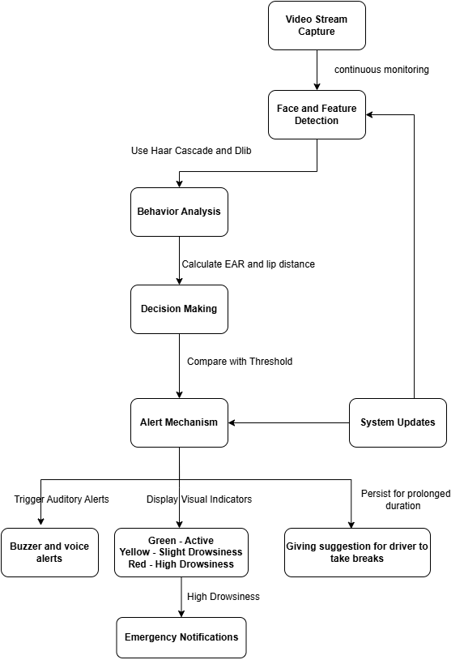
Architecture
Figure 1 : System architecture of (RL-TIME-DROWSINESS DETECT –USING OPEN –CV & Dlib WITH DL CLASSIFICATION)
8
8 Apr 2025
RL-TIME-DROWSINESS DETECT –USING OPEN–CV & Dlib WITH DL CLASSIFICATION

Slide 9
MODULE
Data Collection Module:
Gather real-time video feed from a camera focusing on the driver’s face.
Capture facial landmarks required for drowsiness detection (eyes, mouth, head movement).
Store collected frames in a structured dataset for preprocessing and analysis.
2. Preprocessing Module:
Face Detection: Identify and isolate the driver’s face from the video feed.
Image Normalization: Resize and standardize images for consistent input.
Noise Reduction: Apply filters to remove unwanted variations in lighting and background.
Convert images into a usable format for feature extraction.
8 Apr 2025
RL-TIME-DROWSINESS DETECT –USING OPEN–CV & Dlib WITH DL CLASSIFICATION
9

Slide 10
MODULE
3. Processing & Computation Module: Face Tracking: Continuously track facial features in real-time.
Feature Extraction:
Eye Blink Rate:0.25sec Measure blink duration and frequency.
Yawning Detection: Identify yawning through mouth landmarks.
Drowsiness Classification Algorithm:
Analyze features to classify driver state as alert, mildly drowsy, or highly drowsy.
Set threshold values for drowsiness levels.
4. Alert Mechanism Module:
Audio Alerts: A loud buzzer or voice warning.
Visual Alert: A warning message displayed on the screen.
SMS Alert: An automated SMS notification sent to peers with a message.
8 Apr 2025
RL-TIME-DROWSINESS DETECT –USING OPEN–CV & Dlib WITH DL CLASSIFICATION
10

Slide 11
MODULE
5. Testing & Evaluation Module:
Evaluate accuracy of face detection and tracking algorithms.
Test drowsiness detection under different lighting and facial angles.
Debug false positives and false negatives in the alert system.
6. Deployment Module:
Deploy the model on a local system or integrate with an embedded system in vehicles.
Optimize real-time processing for smooth execution.
Ensure minimal computational overhead for real-time alerts.
8 Apr 2025
RL-TIME-DROWSINESS DETECT –USING OPEN–CV & Dlib WITH DL CLASSIFICATION
11

Slide 12
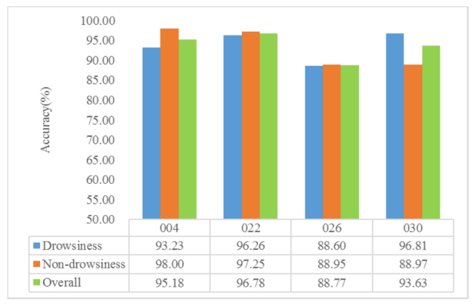
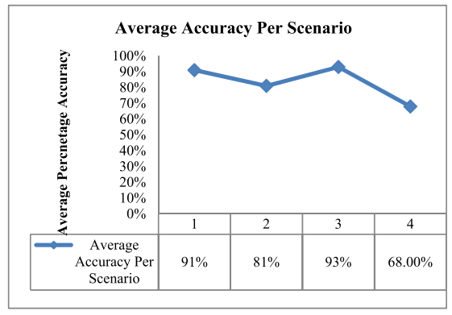
Exp
Experimentation Results
8 Apr 2025
RL-TIME-DROWSINESS DETECT –USING OPEN–CV & Dlib WITH DL CLASSIFICATION
12

Slide 13
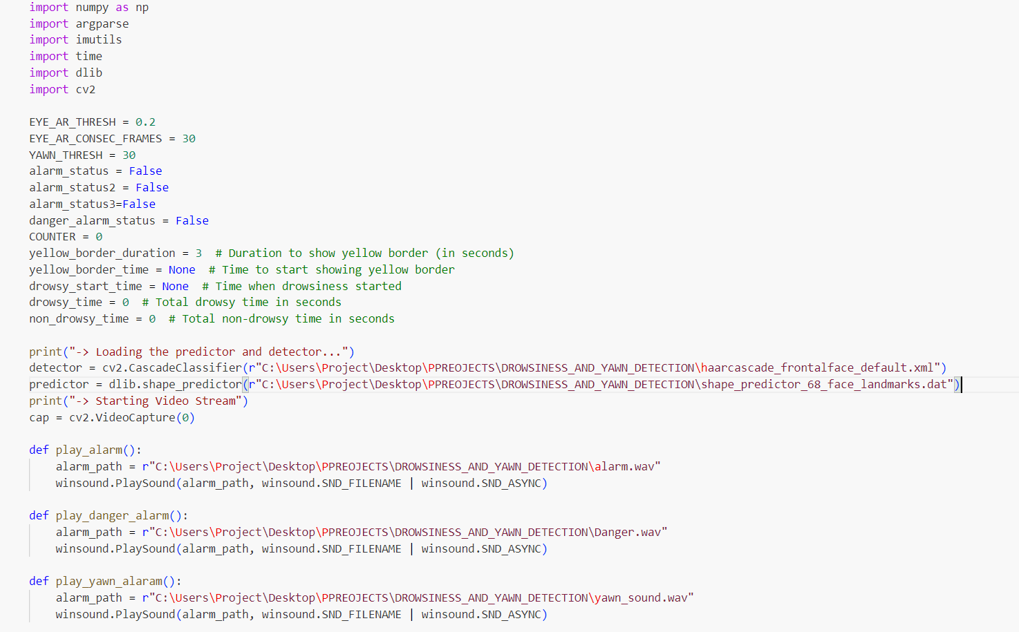
Sample coding
8 Apr 2025
RL-TIME-DROWSINESS DETECT –USING OPEN–CV & Dlib WITH DL CLASSIFICATION
13

Slide 14
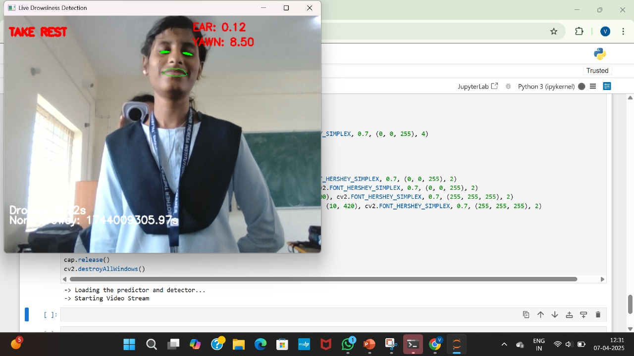
Sample output
8 Apr 2025
RL-TIME-DROWSINESS DETECT –USING OPEN–CV & Dlib WITH DL CLASSIFICATION
14

Slide 15
References
Turki, O. Kahouli, S. Albadran, M. Ksantini, A. Aloui, and M. B. Amara, “A sophisticated drowsiness detection system via deep transfer learning for real time scenarios,” AIMS Math., vol. 9, no. 2, pp. 3211–3234, 2024.
L. Yang, H. Yang, H. Wei, Z. Hu, and C. Lv, “Video-based driver drowsiness detection with optimised utilization of key facial features,” IEEE Trans. Intell. Transp. Syst., early access, Jan. 5, 2024, doi: 10.1109/TITS.2023.3346054.
J. Singh, R. Kanojia, R. Singh, R. Bansal, and S. Bansal, “Driver drowsiness detection system: An approach by machine learning application,” 2023, arXiv:2303.06310.
B. Bhowmick and C. Kumar, "Detection and classification of Eye State in IR Camera for Driver Drowsiness Identification", in Proceedings of the IEEE International Conference on Signal and Image Processing Applications, 2009.
R. Lienhart and J. Maydt, "An Extended Set of Haar-like Features for Rapid Object Detection", in Proceedings of the IEEE International Conference on Image Processing, 2002.
8 Apr 2025
RL-TIME-DROWSINESS DETECT –USING OPEN–CV & Dlib WITH DL CLASSIFICATION
15

Slide 16
THANK YOU
8 Apr 2025
RL-TIME-DROWSINESS DETECT –USING OPEN–CV & Dlib WITH DL CLASSIFICATION
16

